Slide 1
Day 28
Non-parametric Filters

Slide 2
Localizing a Robot in a Hallway
consider a robot moving down a hall equipped with a sensor that measures the presence of a door beside the robot
  the pose of the robot is simply its location on a line down the middle of the hall
  the robot starts out knowing how far down the hallway it is located
    Kalman-like filters require an initial estimate of the location
  robot has a map of the hallway showing it where the doors are

Slide 3
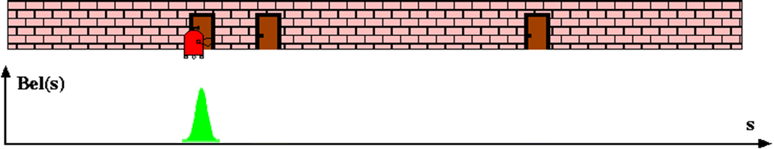
Kalman Localization
robot starts out knowing how far down the hallway it is located

Slide 4
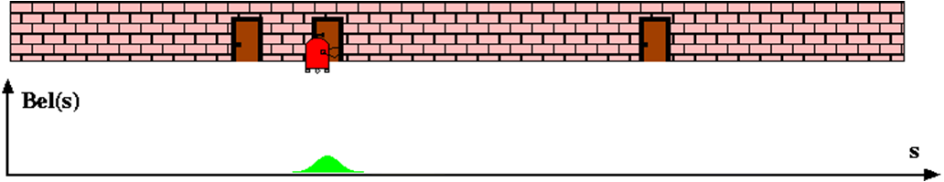
Kalman Localization
as the robot moves forward, its uncertainty in its location shifts and grows according to its motion model

Slide 5
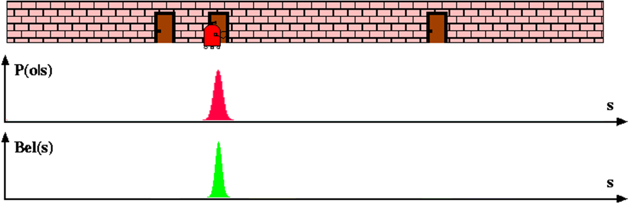
Grid Localization
when it reaches a door that can be uniquely identified, it can incorporate this measurement into its state estimate
measurement liklihood
updated state estimate

Slide 6
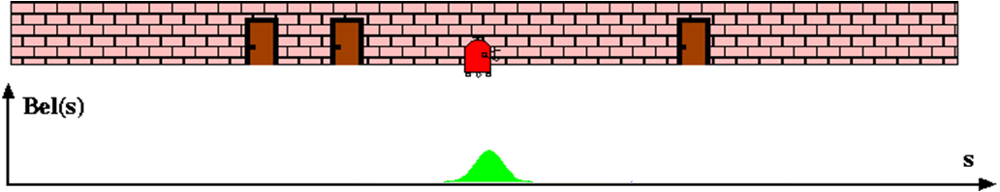
Grid Localization
as the robot moves forward, its uncertainty in its location shifts and grows according to its motion model

Slide 7
Gaussian Assumption
Kalman-like filters assume that quantities can be represented accurately as a mean + covariance
  e.g., the state is a random variable with Gaussian distribution
  e.g., measurements are random variables with Gaussian distribution

Slide 8
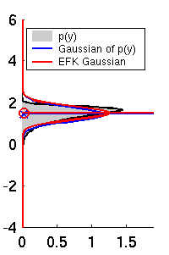
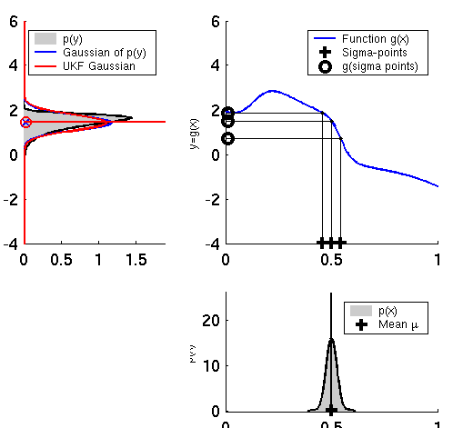
Gaussian Assumption
assumption is ok here
EKF
UKF

Slide 9
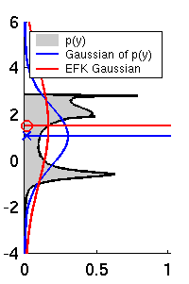
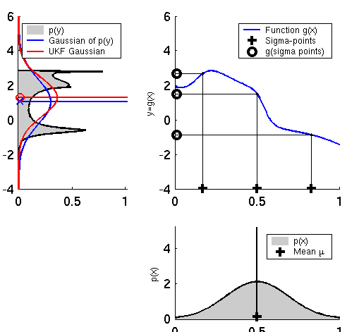
Gaussian Assumption
assumption is (possibly) not ok here
EKF
UKF

Slide 10
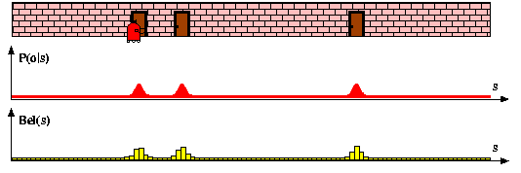
Gaussian Assumption
assumption is not ok here (robot does not know which door it is measuring)
p(x | robot is sensing a door)

Slide 11
Non-parametric Filters
non-parametric filters do not rely on a fixed functional form of the state posterior
instead, they represent the posterior using a finite number of values each roughly corresponding to a region (or point) in state space
two variations
  partition state space into a finite number of regions
    e.g., histogram filter
  represent the posterior using a finite number of samples
    e.g., particle filter

Slide 12
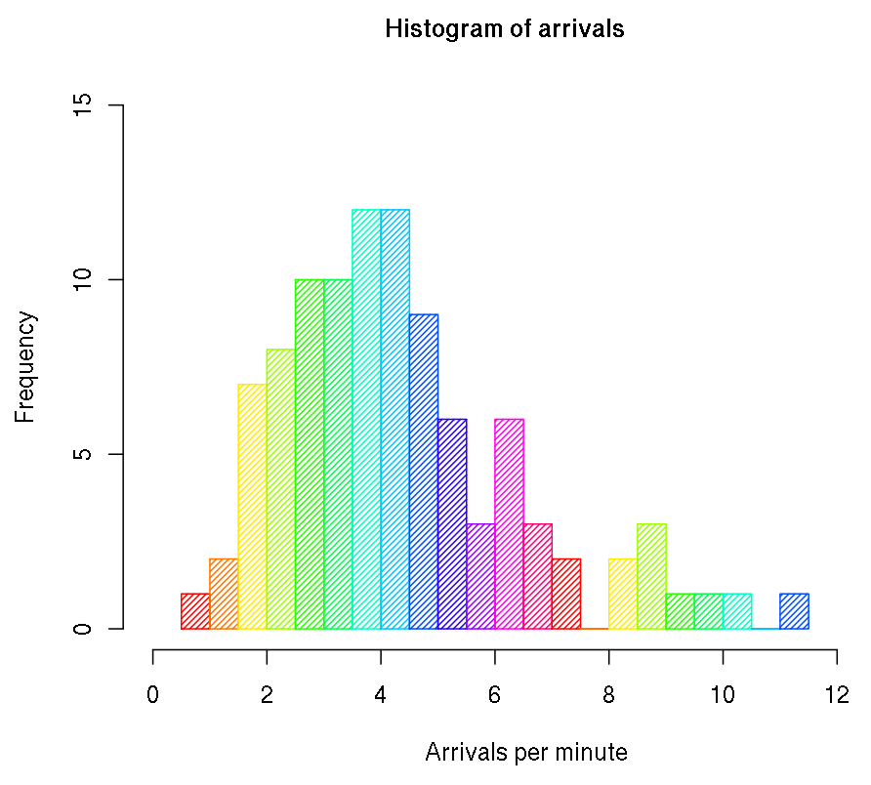
Histogram
“table of frequencies”
bins

Slide 13
Histogram Filter
histogram filter uses a histogram to represent probability densities
in its simplest form, the domain of the densities is divided into subdomains of equal size with each subdomain being a bin of the histogram
  the value stored in the bin is proportional to the density

Slide 14
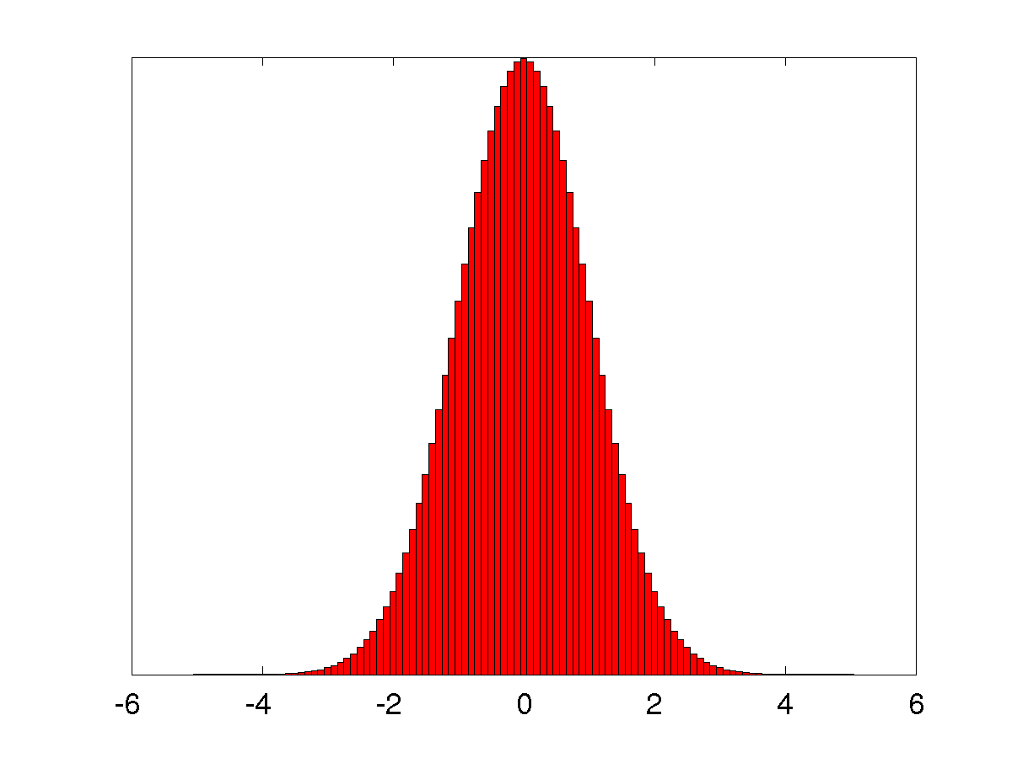
Histogram Filter
suppose the domain of the state x is [-5, 5] and that x is a random variable with Gaussian density (mean 0, variance 1)
  using bins of width w = 0.1 we can represent the density using the following histogram
histogram p
height of bar
Gaussian PDF
center of bin i
x

Slide 15
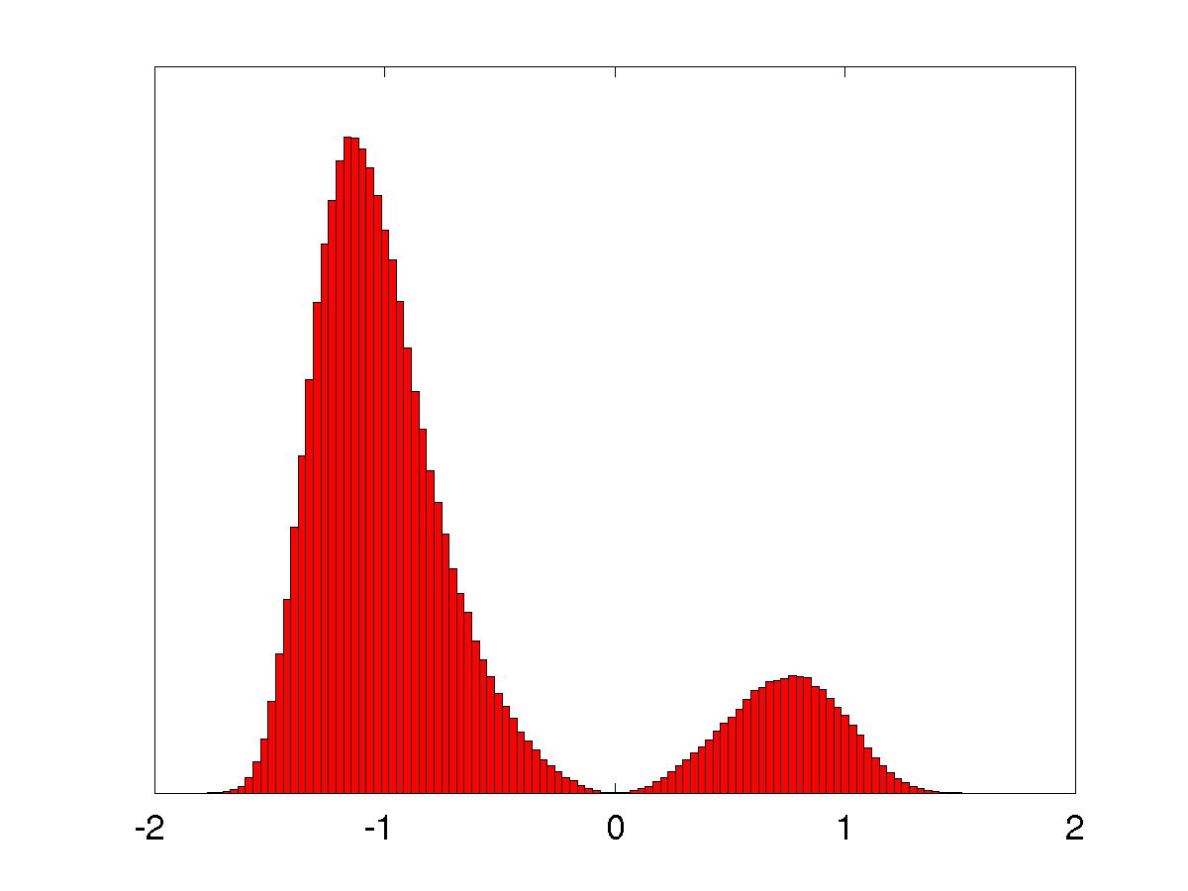
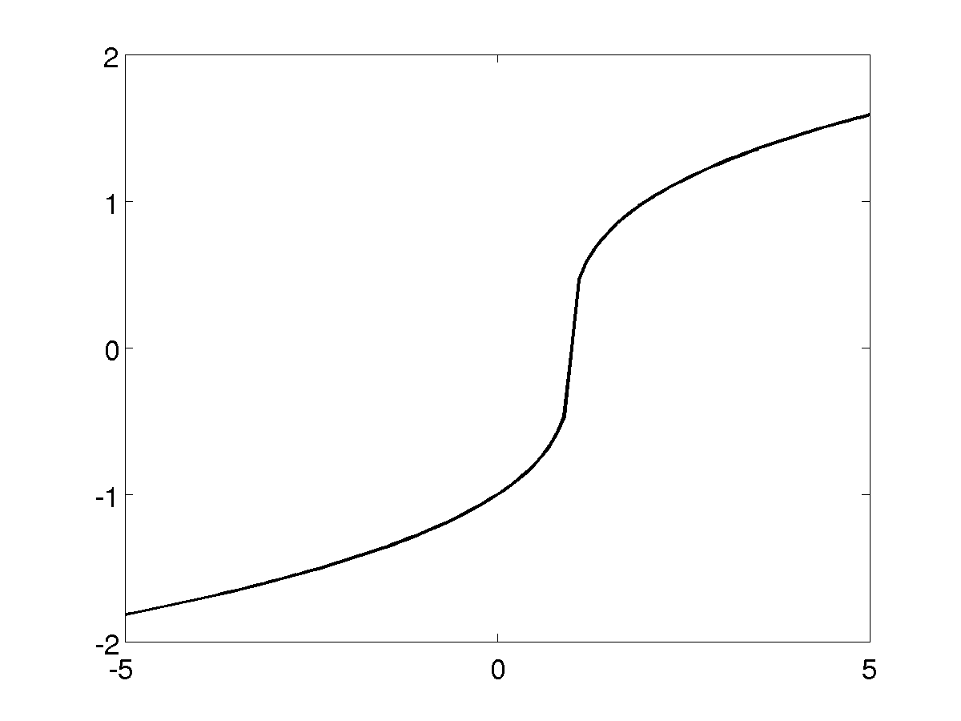
Histogram Filter
suppose we want to pass the density through some non-linear function
reminder: this is the solution obtained
by passing 500,000 random samples
through f (x), not the result of using a
histogram filter

Slide 16
Histogram Filter
create an empty histogram h with bins x_{c,i}
for each i
  y_{i} = f (x_{c,i})
  n_{i} = p(x_{c,i})
  find the bin b_{k} that y_{i} belongs in
  h (b_{k}) = h (b_{k}) + n_{i}

Slide 17
A Simple Implementation
dx = 0.05; % width of x bins
xc = -5:dx:5; % bin centers x
y = nthroot(xc – 1, 3); % y = f(xc)
n = normpdf(xc, 0, 1); % n = p(xc)
dy = 0.1; % width of y bins
yc = -2:dy:2; % bin centers y
h = zeros(size(yc)); % histogram
for i = 1:length(y)
bk = find(y(i) > yc – (dy / 2) & y(i) < yc + (dy / 2));
h(bk) = h(bk) + n(i);
end
bar(yc, h, 1);

Slide 18
Histogram Filter
alternatively
create an empty histogram h with bins x_{c,i}
for each bin b_{k}
probability that y_{i} is in bin b_{k}

Slide 19
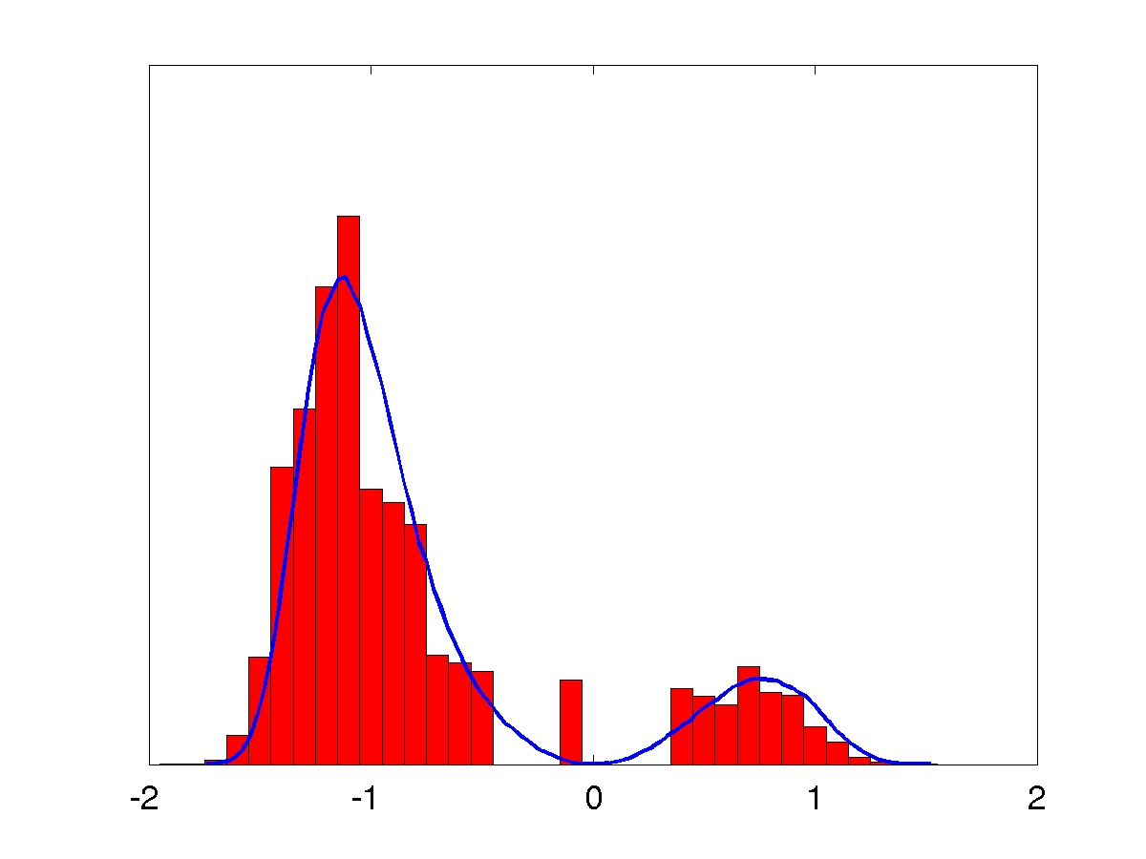
Histogram Filter

Slide 20
Grid Localization
grid localization uses a histogram filter over a grid decomposition of pose space
consider a robot moving down a hall equipped with a sensor that measures the presence of a door beside the robot
  the pose of the robot is simply its location on a line down the middle of the hall
  the robot starts out having no idea how far down the hallway it is located
  robot has a map of the hallway showing it where the doors are
  grid decomposes the hallway into a finite set of non-overlapping intervals
    e.g., every 50cm would yield intervals [0, 0.5], (0.5, 1], (1, 1.5], …

Slide 21
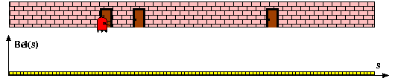
Grid Localization
the robot starts out having no idea how far down the hallway it is located
  the histogram of its state density is uniform

Slide 22
Grid Localization
because the robot is beside a door, it has a measurement
  it can incorporate this measurement into its state estimate
measurement liklihood
updated state estimate

Slide 23
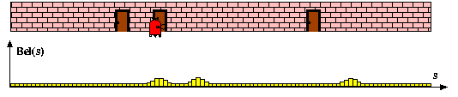
Grid Localization
as the robot moves forward, its uncertainty in its location shifts and grows according to its motion model

Slide 24
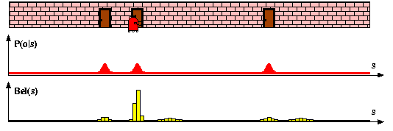
Grid Localization
when it reaches a door, it can incorporate this measurement into its state estimate
  it now has a pretty good idea where it is in the hallway
measurement liklihood
updated state estimate

Slide 25
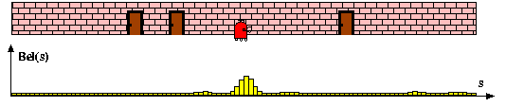
Grid Localization
as the robot moves forward, its uncertainty in its location shifts and grows according to its motion model

Slide 26
Grid Localization Algorithm
algorithm_grid_localization( )
for all k do
motion_model( )
measurement_model( )
endfor
return
histogram
control input
measurement
map
center of mass of grid cell x_{i}

